Slide 1
Tutorial on CVM Tools
Manochehr Bahavar CVM Topical Workshop
May 13-14, 2024

Slide 2
Presentation Overview
Current State
Future Plan
Hands-on installation
Fundamentals

Slide 3
Presentation Overview
Fundamentals

Slide 4
Formats
Format | Type | Description
GeoCSV | ASCII | An extension of the human readable, CSV (Comma-Separated Values) format with extensive metadata (more)
netCDF | Network Common Data Form (netCDF) , Version 4 Classic | Provides the netCDF-4 performance benefits while using the classic data model. Supports compression to reduce the file size (more)
Zarr or HDF5 | TBD
Metadata
Every file, irrespective of its format, will be equipped with comprehensive metadata, adhering to the CF Metadata Conventions.
This standardization guarantees seamless data management and interoperability across various platforms and tools.
With uniform metadata, users can efficiently search, share, and analyze data, enhancing collaboration and decision-making processes.
Enhanced Coordinate Support
The proposed GeoCSV and netCDF file formats support both projected coordinate variables (x and y) and the geographic latitude and longitude variables. This would facilitate model query and visualization based on (x,y) or (longitude, latitude) coordinates.

Slide 5
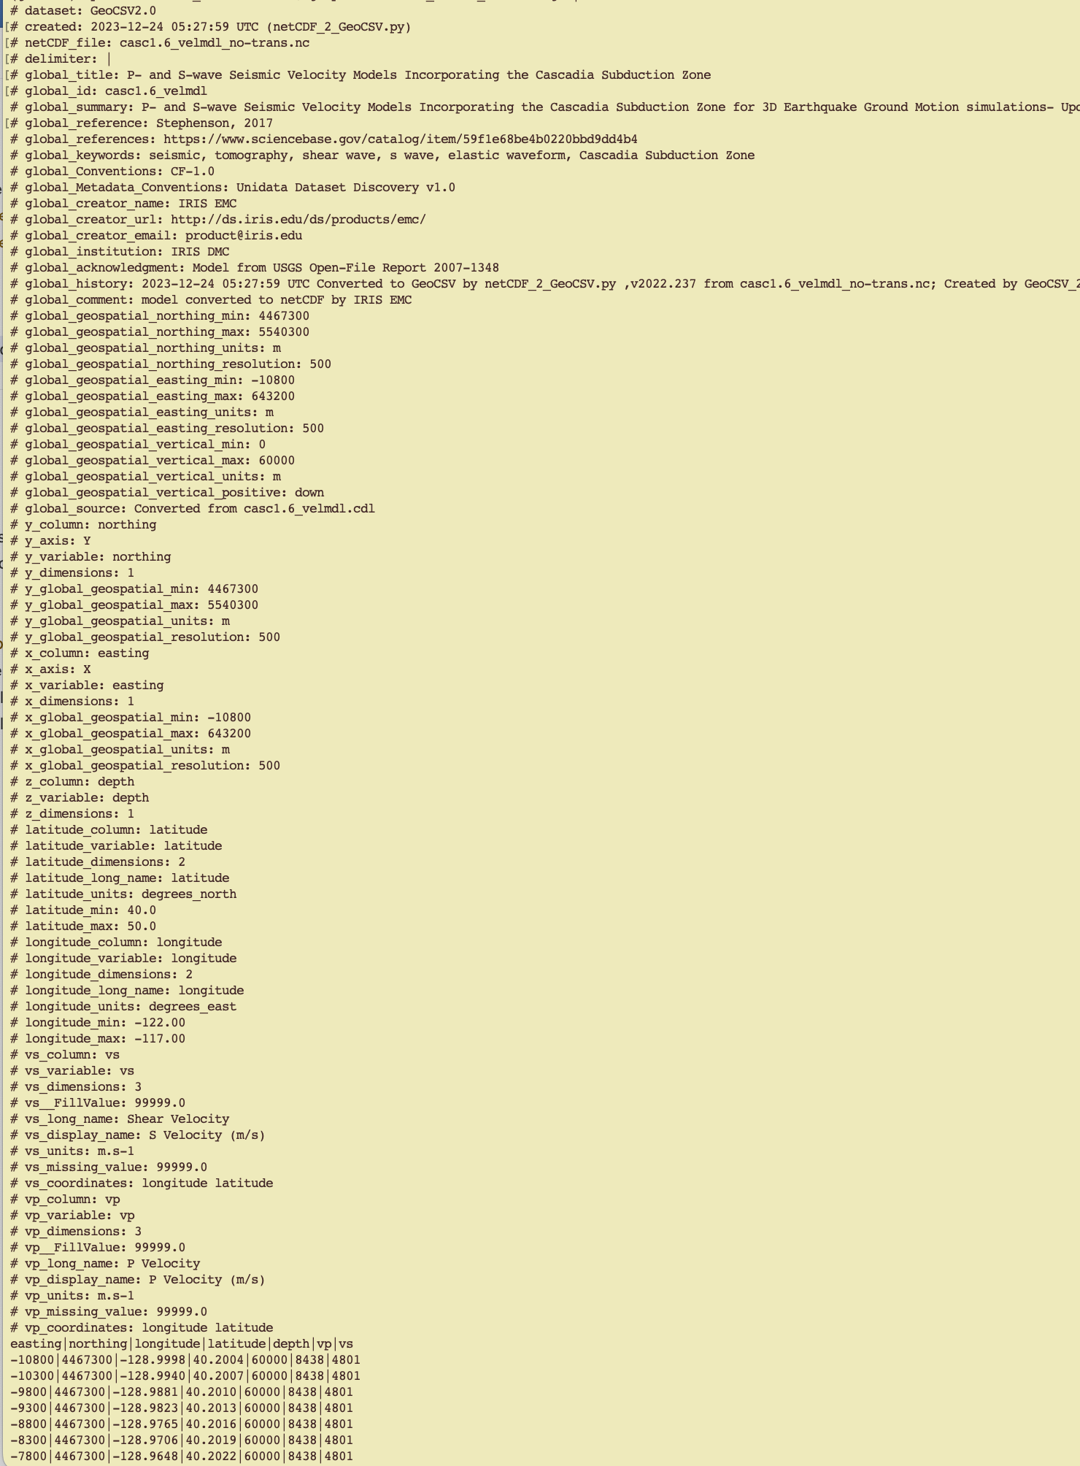
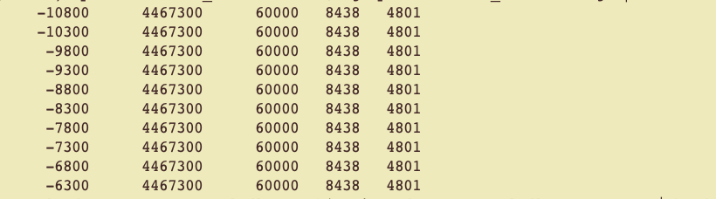
GeoCSV Structure - Example
Stephenson’s
casc1.6_velmdl model
Metadata
Data

Slide 6
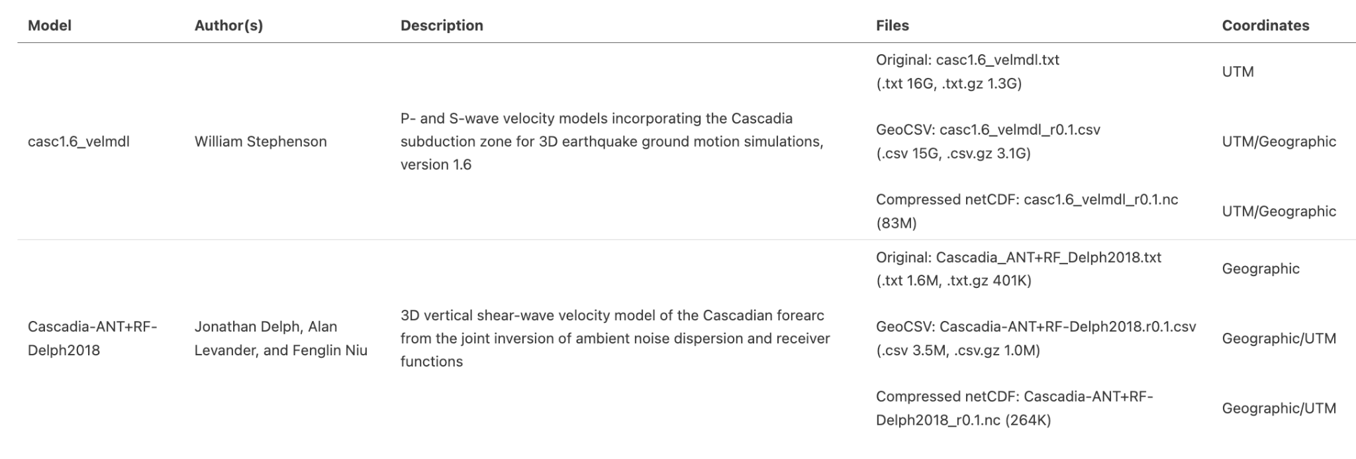
Converted Files
Sample files are available under the Google Drive Folder
(1.3G)

Slide 7
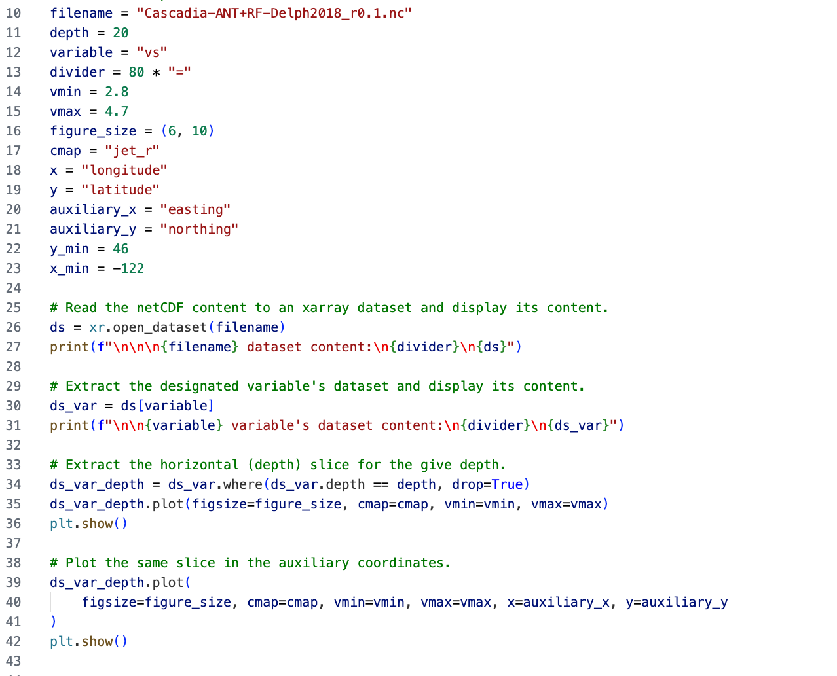
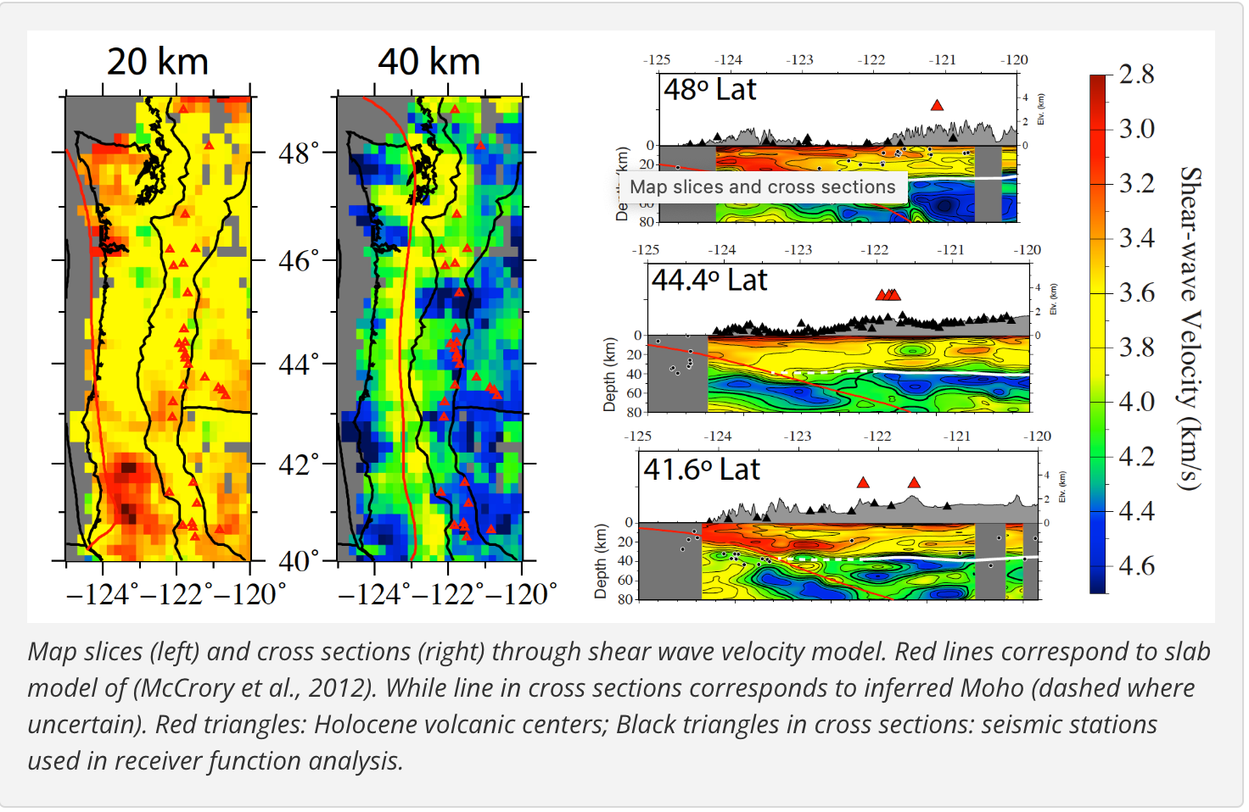
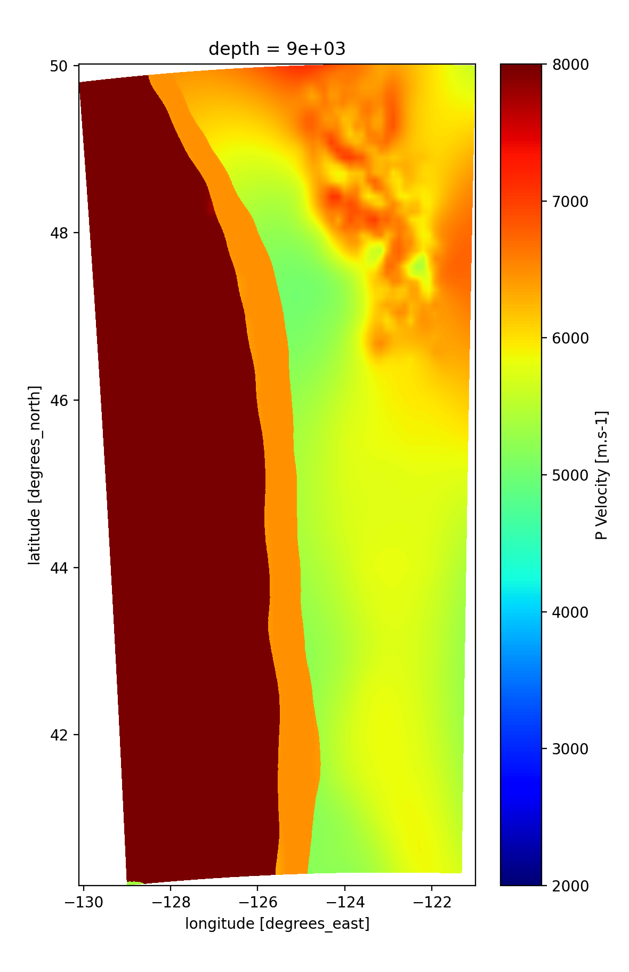
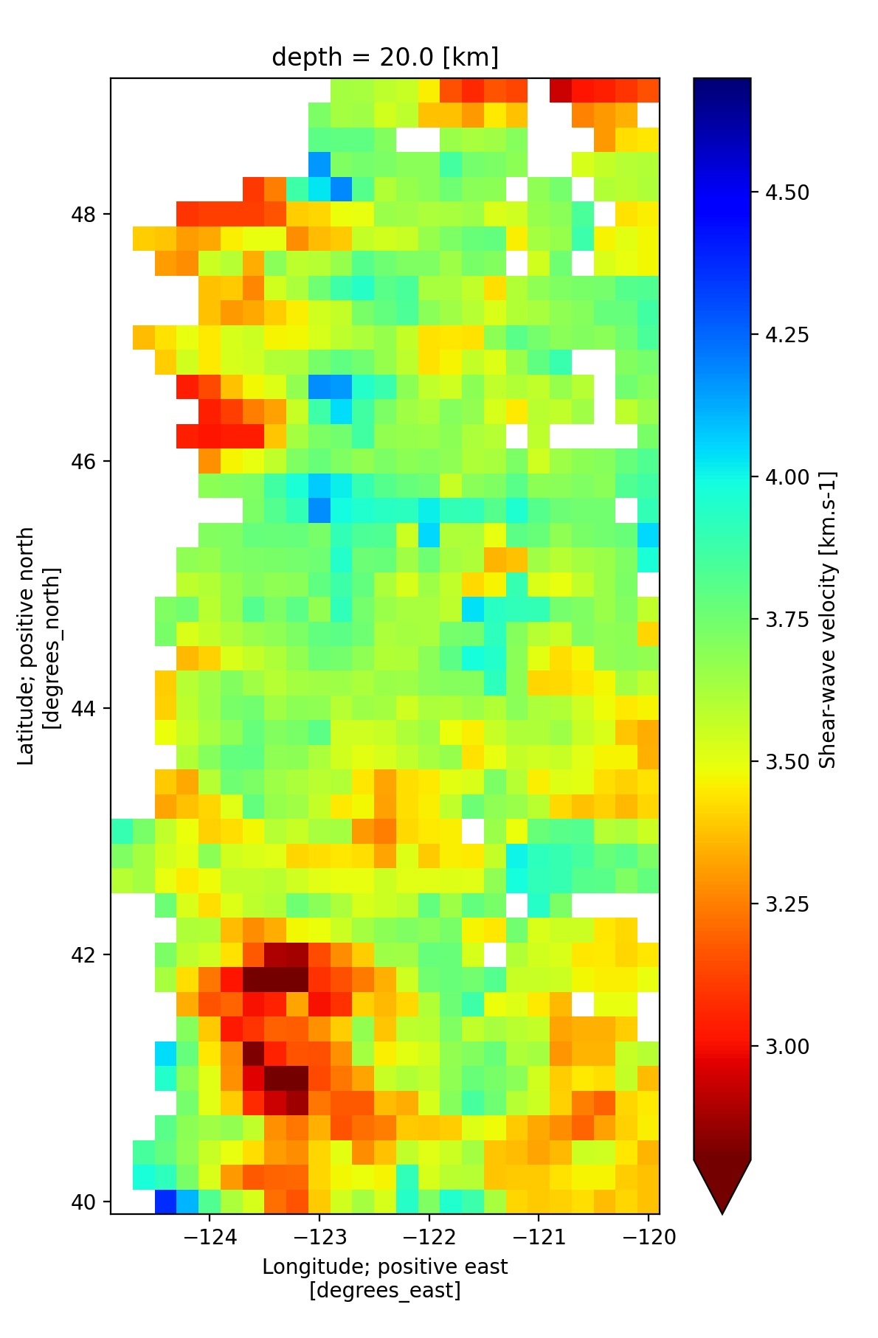
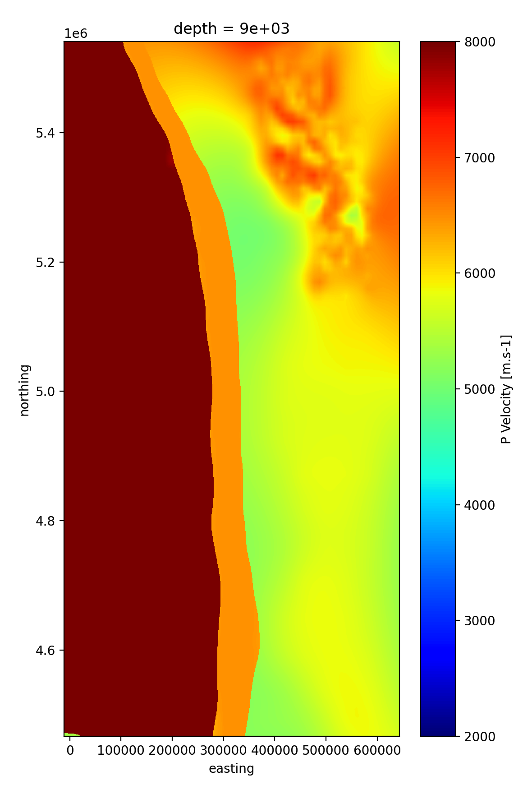
Exploring the netCDF Files Using Xarray

Slide 8
Presentation Overview
Fundamentals
Current State

Slide 9
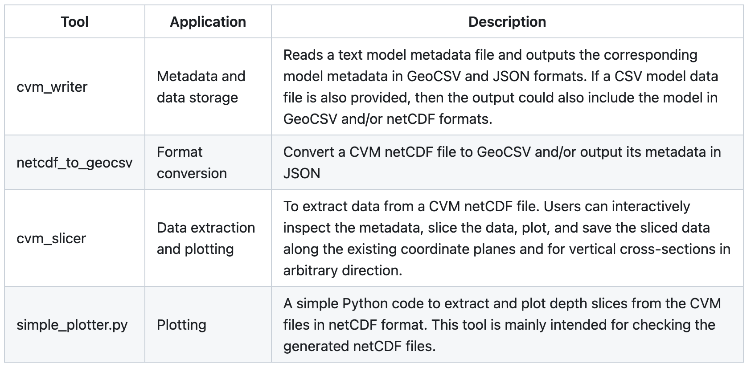
Tools Developed
GitHub Repository
Installation notes

Slide 10
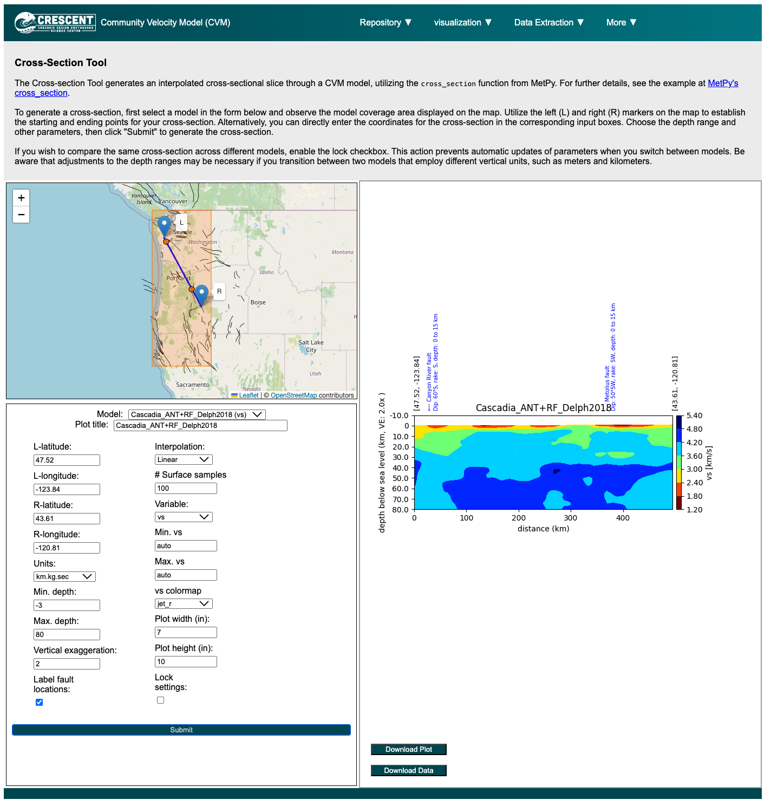
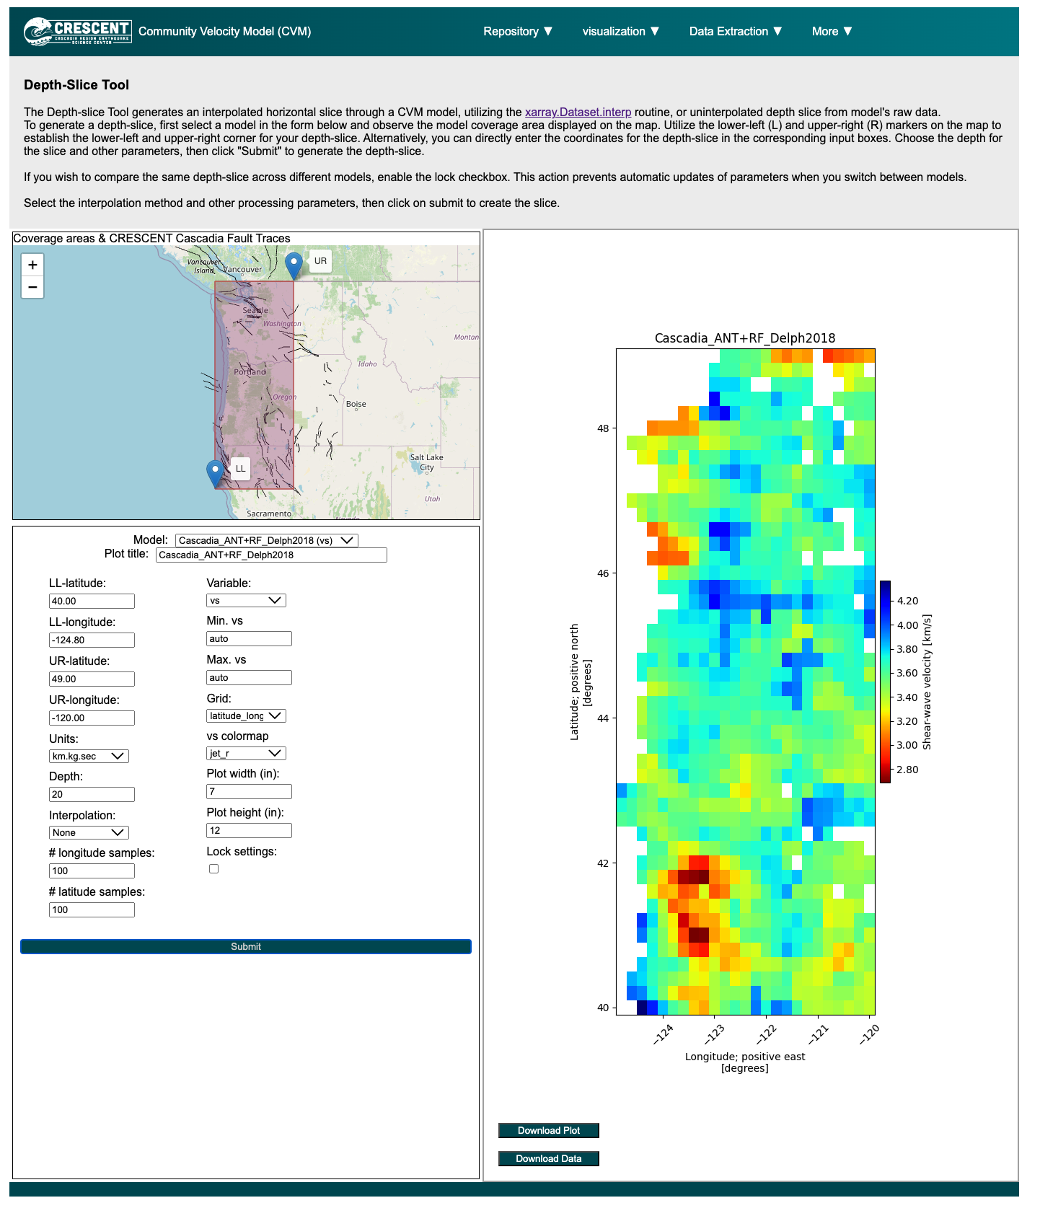
CVM Tools Online

Slide 11
Presentation Overview
Current State
Future Plan
Fundamentals

Slide 12
Future Plan
Current tools
Support for HDF5
More format conversion tools: NonLinLoc GeoModelGrids SeisSol

Slide 13
Presentation Overview
Current State
Future Plan
Hands-on installation
Fundamentals

Slide 14
GitHub repository folder via Google Drive link
https://drive.google.com/drive/folders/1GcEtjm-T9qiSy5VRTCxN-STjtuYrC155?usp=share_link
Install the required packages
Python 3
Python modules listed in requirements.txt
Install these modules with pip install -r requirements.txt
This package has been tested under Python 3.12.0 on macOS 14.2.1. It may work with older Python 3 versions.

Slide 15
cvm_writer - get started
Input: text model metadata file output: model metadata in GeoCSV and JSON formats
NOTE: Templates for the metadata files are available under the template folder. You can use either metadata_template_detailed.txt or metadata_template.txt for model's metadata. The only difference is that the metadata_template_detailed.txt has full description for the model parameters.
# Rules:
# Blank lines and lines starting with # are ignored
# Each parameter should be defined on a new line with key=value format (quotes are not required)
# Lines starting with "-" indicate a new parameter definition
# Lines starting with ">" indicate a new parameter grouping.
# - Each parameter group should contain one or more parameter definition (key=value) on a new line
# - The leading and trailing blank spaces are ignored
# Lines starting with ">>" indicate a new parameter sub-grouping.
# - Each parameter sub-group should be nested under a parameter group
# - Each parameter sub-group should contain one or more parameter definition (key=value) on a new line
# - The leading and trailing blank spaces are ignored
> delimiter
data =
geocsv = | > model
model = Cascadia_ANT+RF_Delph2018
title = 3D vertical shear-wave velocity model of the Cascadian forearc from the joint inversion of ambient noise dispersion and receiver functions
summary = Cascadia_ANT+RF_Delph2018 was created from the joint inversion of ambient noise Rayleigh waves dispersion measurements (8-50 seconds)....
reference = Delph, Levander, and Niu (2018)
reference_pid = doi:10.1029/2018gl079518
data_revision = r0.1
version = v0.0

Slide 16
cvm_writer - metadata output example
Input: text model metadata file output: model metadata in GeoCSV and JSON formats
NOTE: Templates for the metadata files are available under the template folder. You can use either metadata_template_detailed.txt or metadata_template.txt for model's metadata. The only difference is that the metadata_template_detailed.txt has full description for the model parameters.
cd to the model directory sample-files/Cascadia-ANT+RF-Delph2018
Cascadia-ANT+RF_meta.txt is the metadata file
./../src/cvm_writer.py -m Cascadia-ANT+RF_meta.txt -o Cascadia-ANT+RF-test -t metadata -m Cascadia-ANT+RF_meta.txt is the metadata file -o Cascadia-ANT+RF-test is the output filename (a postfix of _metada will be added to the filename) -t metadata tells the code that we only want the metadata files.
After running the above command, you should see two new files in your model directory: Metadata JSON file: Cascadia-ANT+RF-test_metadata.json Metadata GeoCSV file: Cascadia-ANT+RF-test_metadata.csv

Slide 17
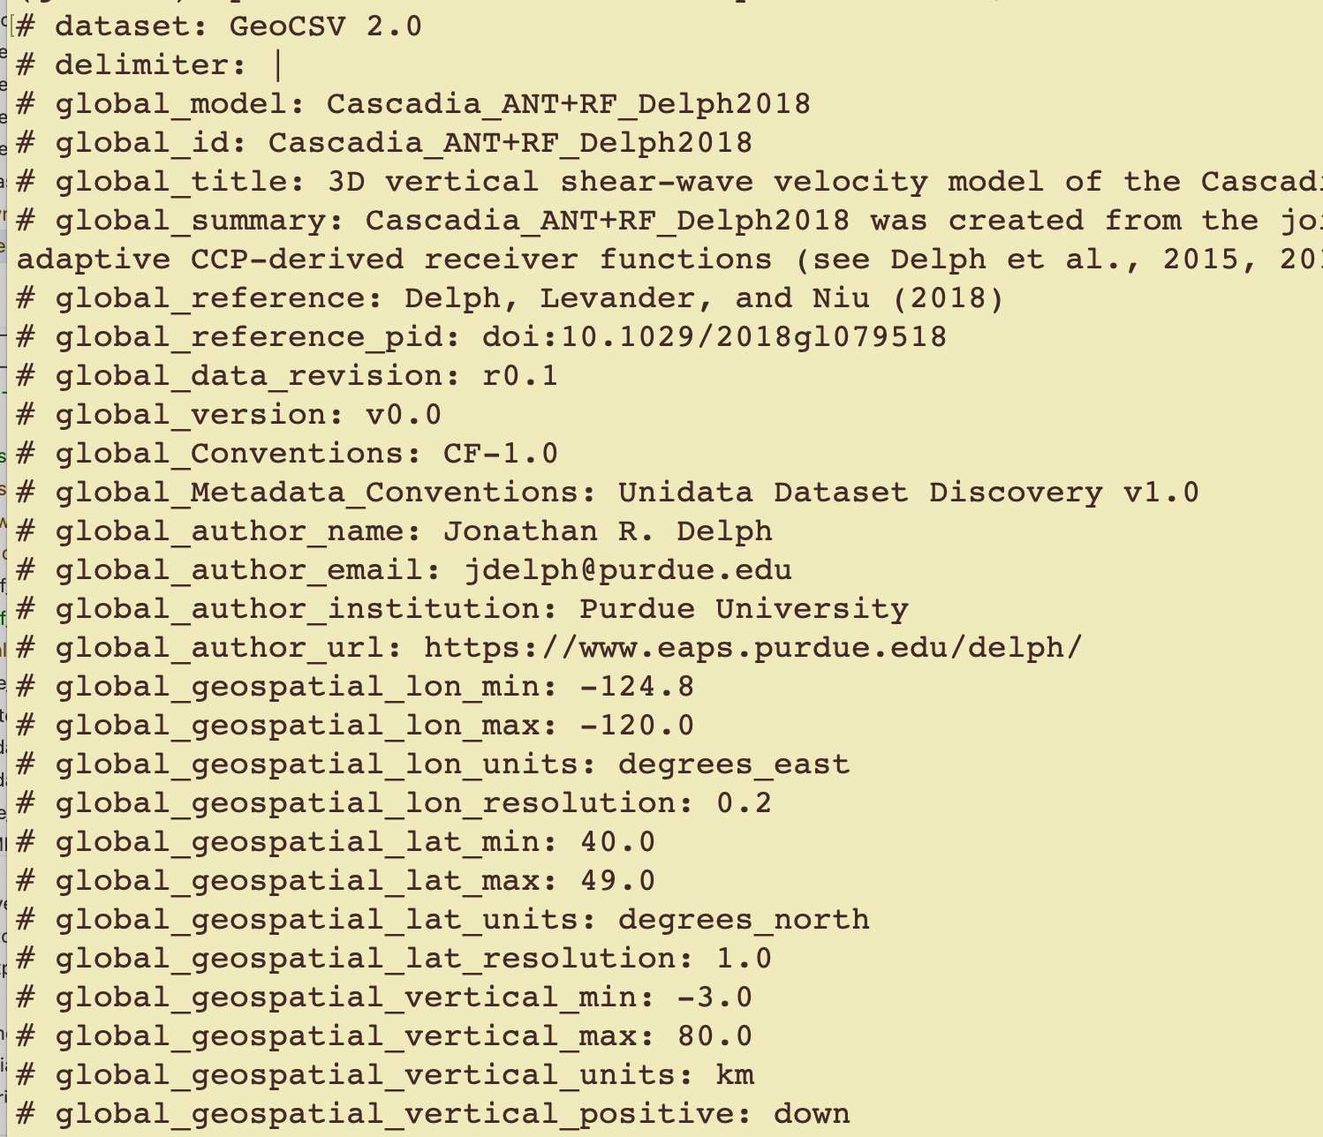
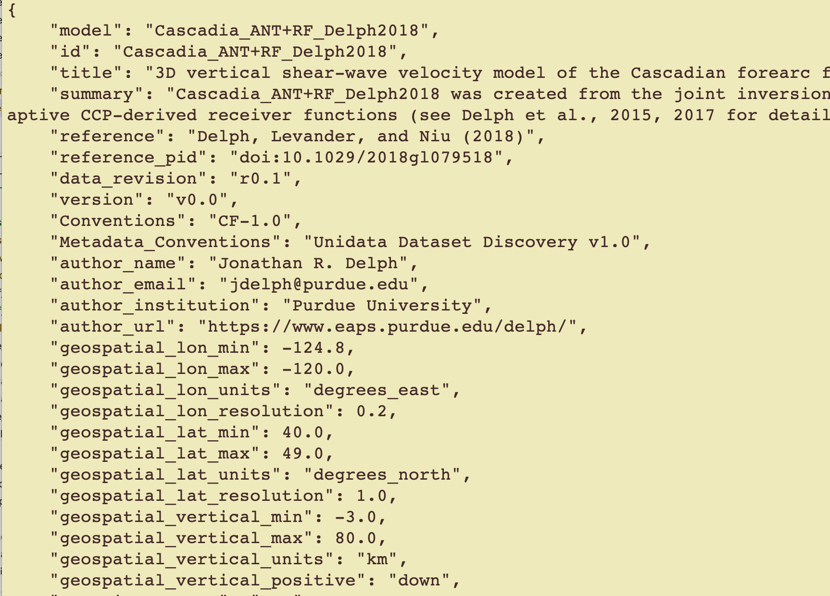
cvm_writer - metadata output example
Metadata GeoCSV file: Cascadia-ANT+RF-test_metadata.csv
Metadata JSON file: Cascadia-ANT+RF-test_metadata.json

Slide 18
cvm_writer - model output example
Input: text model metadata + CSV model data files output: model in GeoCSV and/or netCDF formats
The Cascadia_ANT+RF_Delph2018.txt.gz file is the raw data file for the model.
Unzip it and copy it to a file (for example Cascadia-ANT+RF_data.txt) for testing. All model data files need to have a header as their first line that identifies the columns in the file using the same delimiter as data between column names: longitude latitude depth vs NOTE: the delimiter parameter should have been defined in the metadata file
Create the netCDF model files by running: ../../src/cvm_writer.py -m Cascadia-ANT+RF_meta.txt -o Cascadia-ANT+RF-test -d Cascadia-ANT+RF_data.txt -t netcdf -d Cascadia-ANT+RF_data.txt is the model data -t netcdf we want the output to be in netCDF NOTE: we could have used -t geocsv to have the output as GeoCSV file or we could have combined them all and have -t metadata,netcdf,geocsv to get all the outputs Model netCDF file: Cascadia-ANT+RF-test.nc

Slide 19
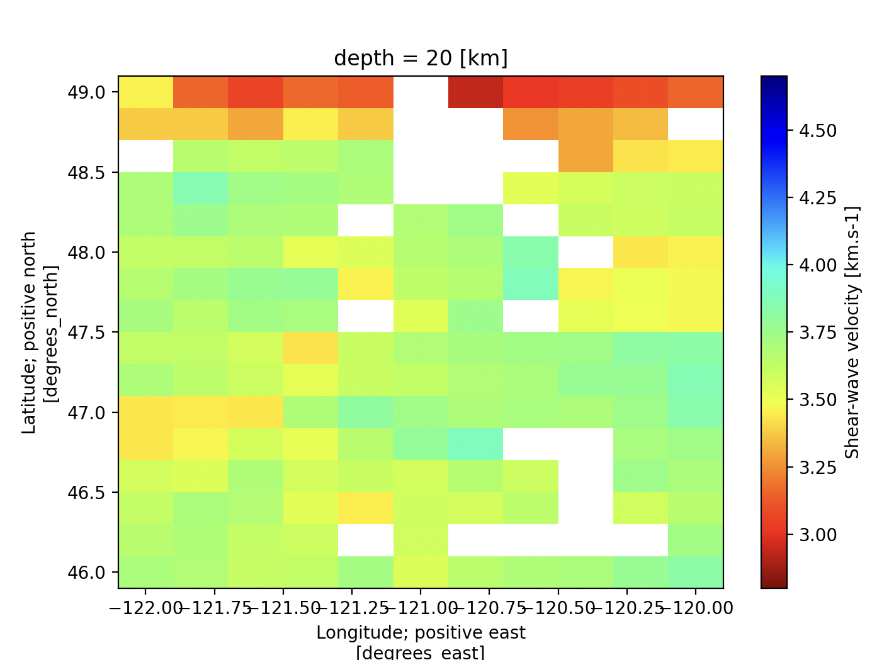
Working with netCDF Files Using Xarray
Needs a configuration file (provided): simple_plotter_prop.py
filename = "Cascadia-ANT+RF-Delph2018.r0.1.nc"
depth = 20
variable = "vs"
vmin = 2.8
vmax = 4.7
figure_size = (6, 10)
figure_size_s = (4, 4)
cmap = "jet_r"
x = "longitude"
y = "latitude"
auxiliary_x = "easting"
auxiliary_y = "northing"
y_min = 46
x_min = -122
../../src/simple_plotter.py -i Cascadia-ANT+RF-test.nc Slice at the depth of 20km in moel coordinates
Slice at the depth of 20km in auxiliary coordinates
Slice at the depth of 20km of a subsection

Slide 20
netcdf_to_geocsv
Convert a netCDF CVM file to GeoCSV format and optionally output its metadata as JSON
Input: netCDF model file output: model in GeoCSV and metadata JSON formats
NOTE: The output will have the same name as the input file
cd to the model directory sample-files/Cascadia-ANT+RF-Delph2018
Convert the netCDF file from the previous slides to GeoCSV: ../../src/netcdf_to_geocsv.py -i Cascadia-ANT+RF-test.nc -g true -m true -i Cascadia-ANT+RF-test.nc name of the input file to convert -g true sets the GeoCSV conversion flag to True -m true sets the metadata output flag to True -o conversion_test is the output file name
After running the above command, you should see two new files in your model directory: GeoCSV file: Cascadia-ANT+RF-test.csv JSON metadata file: Cascadia-ANT+RF-test.json

Slide 21
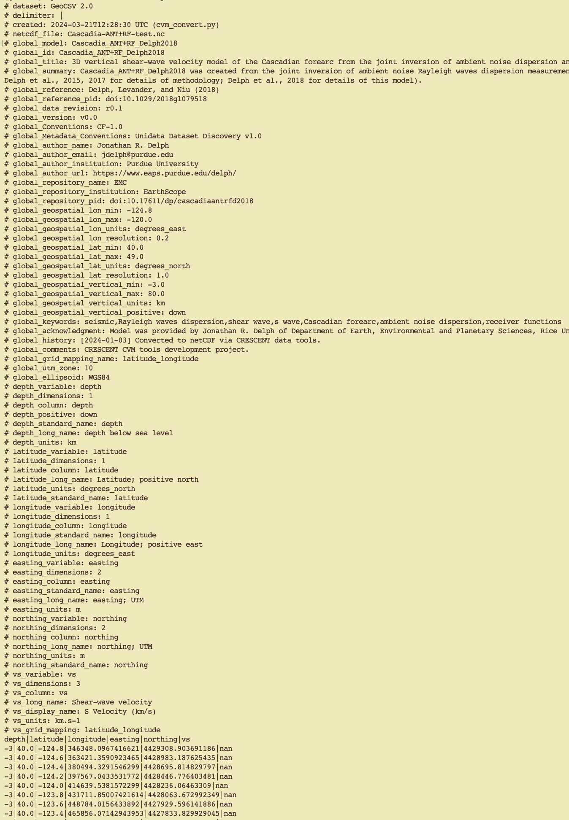
Netcdf_to_geocsv - output
GeoCSV file: Cascadia-ANT+RF-test.csv

Slide 22
cvm_slicer.py - get started
Interact with the netCDF file, visualize and extract data
Input: netCDF model file output: model metadata, subset of model data, plots
cd to the model directory sample-files/Cascadia-ANT+RF-Delph2018
Start interacting with the netCDF file from previous slide: ../../src/cvm_slicer.py -v -i Cascadia-ANT+RF-test.nc -v to run in the verbose mode and provide more information on the required parameters. NOTE: You can remove this tag to run the tool in a less verbose mode. -i Cascadia-ANT+RF-test.nc the netCDF input file
cvm_slicer
----------
Tool for interactively extracting data from a CVM netCDF file.
User can inspect the metadata, slice the data, plot, and save
the sliced data. Slicing can be performed along the existing
coordinate planes or as an interpolated cross-sectional slice through gridded data.
Loaded Cascadia-ANT+RF-test.nc and it is a netCDF file
The available options are:
meta - to view file's metadata
ranges - to display value ranges for variables
subset - to subset the data
----------
help
exit
select option [meta, ranges, subset, help, exit]?

Slide 23
cvm_slicer.py - ranges
Interact with the netCDF file, visualize and extract data
../../src/cvm_slicer.py -v -i Cascadia-ANT+RF-test.nc
select option [meta, ranges, subset, help, exit]? meta
[Metadata] Global attributes:
geospatial_lon_min: -124.8
geospatial_lon_max: -120.0
geospatial_lon_units: degrees_east
geospatial_lon_resolution: 0.2
geospatial_lat_min: 40.0
geospatial_lat_max: 49.0
geospatial_lat_units: degrees_north
geospatial_lat_resolution: 1.0
geospatial_vertical_min: -3.0
geospatial_vertical_max: 80.0
geospatial_vertical_units: km
geospatial_vertical_positive: down
[Metadata] Coordinate Variables:
depth:
positive: down
standard_name: depth
long_name: depth below sea level
units: km
Values:
-3, -2, -1, 0, 1, 2, 3, 4, 5, 6, 7, 8, 9, 10, 11, 12, 13, 14, 15, 16
...
61, 62, 63, 64, 65, 66, 67, 68, 69, 70, 71, 72, 73, 74, 75, 76, 77, 78, 79, 80
latitude:
long_name: Latitude; positive north
units: degrees_north
standard_name: latitude
.
. .
select option [meta, ranges, subset, help, exit]?

Slide 24
cvm_slicer.py - ranges
Interact with the netCDF file, visualize and extract data
../../src/cvm_slicer.py -v -i Cascadia-ANT+RF-test.nc
select option [meta, ranges, subset, help, exit]? ranges
Ranges:
depth: -3.00 to 80.00 km
latitude: 40.00 to 49.00 degrees_north
longitude: -124.80 to -120.00 degrees_east
easting: 346348.10 to 756099.65 m
northing: 4427757.22 to 5431792.86 m
vs: 1.02 to 5.86 km.s-1
select option [meta, ranges, subset, help, exit]?

Slide 25
cvm_slicer.py - subset
Interact with the netCDF file, visualize and extract data
../../src/cvm_slicer.py -v -i Cascadia-ANT+RF-test.nc
select option [meta, ranges, subset, help, exit]? subset
You can subset the data as a:
volume - a subvolume of data
slice - a slice along a coordinate axis
xsection - a vertical slice in an arbitrary direction
----------
back - takes you to the previous step
exit
select [volume, slice, xsection, back, exit]?

Slide 26
cvm_slicer.py - depth slice
select [volume, slice, xsection, back, exit]? slice
A slice cuts the model along one of the coordinate axis.
direction - direction of the slice, the coordinate to cut the model along
----------
back - takes you to the previous step
exit
direction [depth, latitude, longitude, back, exit]?depth slice depth [-3 to 80, back, exit]?20
Select slice limits in the latitude direction.
limits - provide minimum,maximum or press enter to accept the full range default
----------
back - takes you to the previous step
exit
latitude limits [default values (40.0, 49.0), back, exit]: longitude limits [default values (-124.8, -120.0), back, exit]:
The sliced data summary:
<xarray.Dataset> Size: 28kB
Dimensions: (latitude: 46, longitude: 25)
Coordinates:
depth int64 8B 20
* latitude (latitude) float64 368B 40.0 40.2 40.4 40.6 ... 48.6 48.8 49.0
* longitude (longitude) float64 200B -124.8 -124.6 -124.4 ... -120.2 -120.0
easting (latitude, longitude) float64 9kB 3.463e+05 ... 7.194e+05
northing (latitude, longitude) float64 9kB 4.429e+06 ... 5.432e+06
Data variables:
vs (latitude, longitude) float64 9kB nan nan 4.367 ... 3.097 3.152

Slide 27
cvm_slicer.py - depth slice
What to do with the slice.
plot2d - a 2D plot of ['latitude', 'longitude']
plot3d - a 3D plot of ['latitude', 'longitude'] and the model variable on the 3rd axis.
The plot is interactive and can be rotated.
gmap - a 2D plot of ['latitude', 'longitude'] in geographical coordinate system
cmap - change the color map for the plots
save - save the slice data
----------
back - takes you to the previous step
exit
Action [plot2d, plot3d, gmap, cmap, save, back, exit]:

Slide 28
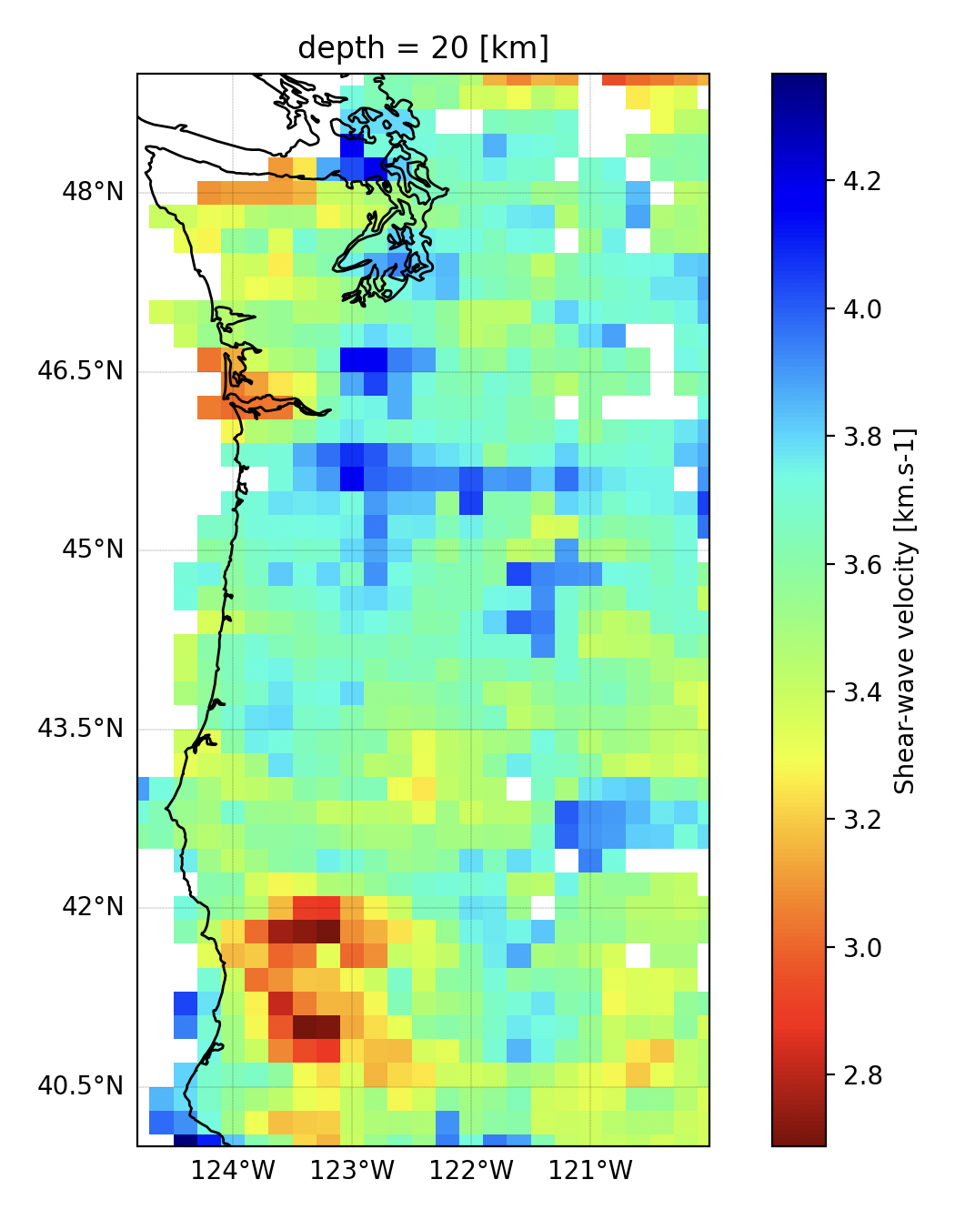
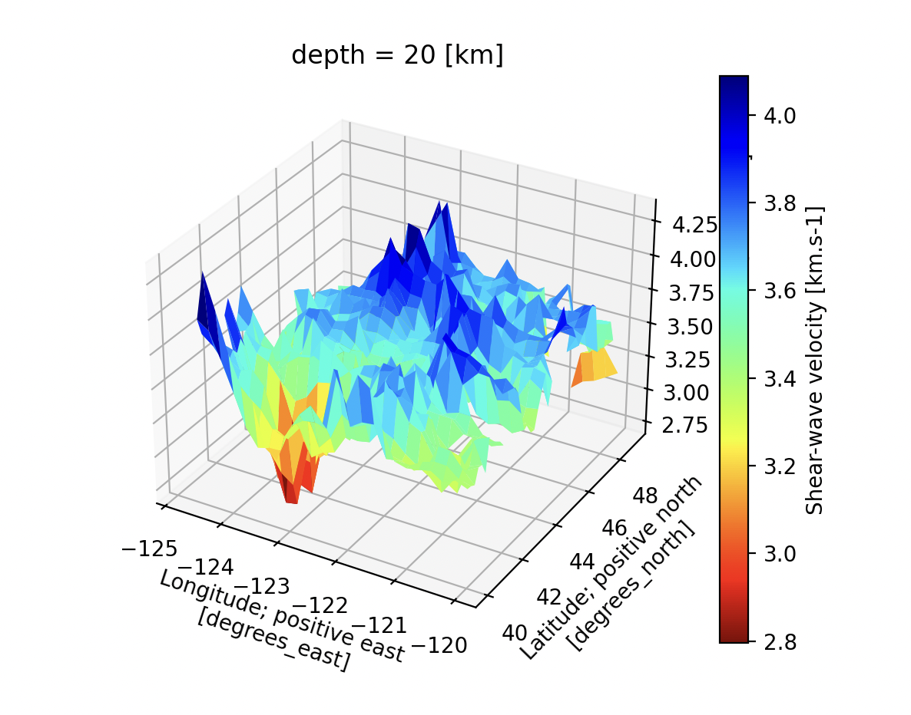
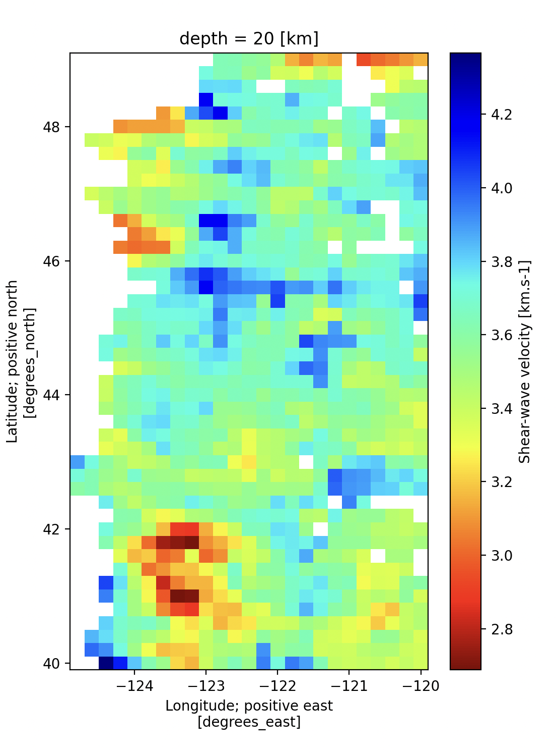
cvm_slicer.py - gmap
Action [plot2d, plot3d, gmap, cmap, save, back, exit]:gmap
Action [plot2d, plot3d, gmap, cmap, save, back, exit]:plot2d
Action [plot2d, plot3d, gmap, cmap, save, back, exit]:plot3d

Slide 29
cvm_slicer.py
Many options to explore

Slide 30
Questions?
Your feedback is highly appreciated. For questions, comments and suggestions please contact Manoch:
manochehr.bahavar@earthscope.org

